Slide 1
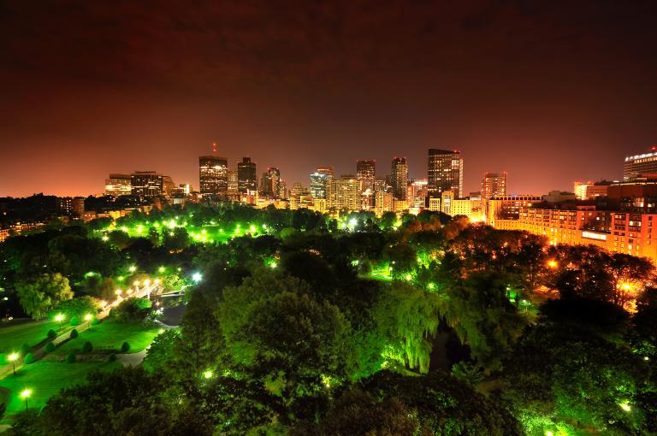
Boston Energy Analysis & Insights
Team 6 : Prateek Mane
Nikita Khamkar
Rashmi Yadav

Slide 2
BACKGROUND
The given datasets contain energy consumption data for Boston city in year 2014 for different location and buildings.
Buildings can be categorized as Hospital, College, Library, Property etc. and area as Copley sq., Dudley sq., Roxbury etc. locations of Boston.
The energy consumption is supposed to be dependent on Building, area, time etc. variables

Slide 3
BUSINESS
Macro Analysis: Analysis of energy usage on basis on area, Building and time. This analysis will require the data of energy usage of all the location in Boston over the year. Will further analyze the energy consumption In peak hour.
Micro Analysis: Analyzing the popular area of Boston where the energy consumption is high and comparing it with other area.

Slide 4
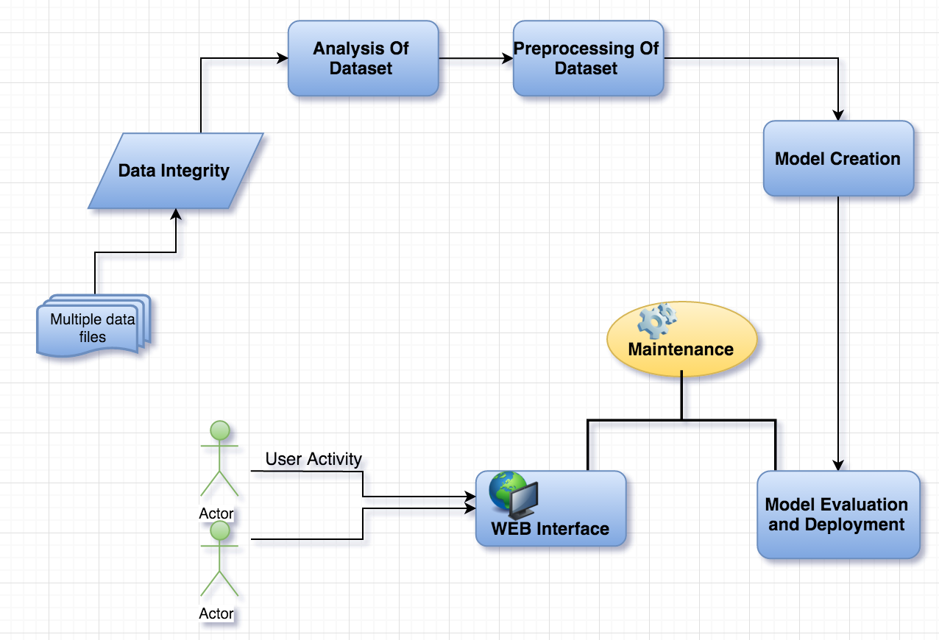
PROCESS FLOW

Slide 5
Technologies Used
Website
Frontend
HTML5
Bootstrap
CSS
Jquery
Backend
NodeJS
Python
Deployment
AWS
Data Cleansing
R
Python
Excel
Data Visualization
Tableau
Machine Learning
Microsoft Azure ML Studio

Slide 6
Data Transformation
Data
Input Data
Transformed Data
The input data recorded the energy consumption per 5 mins in the entire day for
In the transformed data, R script was used to transpose the per 5 min column to a single new column named ‘variable’.
Three new columns were added:-
Area – Location of the building
Building Type – The type of building
Weekday – 0 -> The given date is a weekday 1-> the given date is a weekday
Season – 1 -> Fall 2 ->Spring 3 ->Summer 4 -> Fall 0-> Winter

Slide 7
Data Cleansing
The columns kwh and power factor had missing values.
After transposing the data, the value in the variable column got changed. This was treated using Python
Before transformation – 0:05
After cleaning – 0.05
Tools Used
Excel
R
Python

Slide 8
Prediction Model
5 models were created based on building type in windows Azure ML Studio
Model Types:-
School
Boston Fire Department
Boston Police Department
Property Management
Boston Public Library
Model Performance
Model | Linear Regression | Boosted Decision Tree
School
Boston Fire Department
Boston Police Department
Property Management
Boston Public Library

Slide 9
Deployment
Model Deployment
5 Models based on building type were deployed on Microsoft Azure ML Studio.
5 models are uniquely identified by 5 unique API keys
Website Deployment
Website was deployed on AWS EC2 instance.
Website - http://52.38.108.155:4030/
GitHub - https://github.com/prateekmane99/ADS

Slide 10
Thank You …..
And now your questions?

